Slide 1


INTEL PRODUCTS SENTIMENT ANALYSIS FROM ONLINE REVIEWS

Slide 2

MOHAMMED SAQIB.B 230282601082
ABDUL RAHMAN.J 230282601003
KISHORE.S
230282601050
KEERTHANA.E
230282601047
KAVIPRIYA K
230282601045
The Analytics team

Slide 3

Agenda
Introduction
Solution
Features Offered
Process Flow
Architecture Diagram
Technologies Used
Visualization
Team Members And Contribution
Conclusion And Recommendation

Slide 4
INTRODUCTION
In today's digital age, consumer opinions and sentiments expressed through online reviews play a pivotal role in shaping product development and marketing strategies. This presentation explores how Natural Language Processing (NLP) techniques can be leveraged to analyze sentiment from online reviews of Intel products. By explore datasets sourced from diverse platforms such as Amazon, Twitter, HotHardware, Tom'sHardware, and Reddit, spanning the last 3 to 5 years..

Slide 5

Concept:
Utilizing Natural Language Processing (NLP) to extract sentiments from online reviews.
Key Features:
Automated sentiment analysis pipeline.
Real-time feedback aggregation.
Customizable sentiment scoring and categorization.
SOLUTION

Slide 6
SENTIMENT ANALYSIS PIPELINE
Description:
Integration of pre-trained NLP models to analyze sentiment.
Benefits:
Scalability and accuracy in sentiment extraction.
FEATURES OFFERED

Slide 7
Process FLOW
1
Data Understanding
2
Data Cleaning
3
Data Modelling
4
Data Analysis
5
Uncover Insights

Slide 8
Architecture Diagram
Data Collection
Data Preprocessing
Sentiment Analysis
RoBERTa
VADER
Model Training & Evaluation
Results and Analysis

Slide 9
Technologies used
Programming Languages: Python (NLTK, spaCy) for NLP, Flask for web framework.
Machine Learning: Transformers library for sentiment analysis.
Tools: Jupyter Notebook for experimentation, pickle for model serialization.

Slide 10
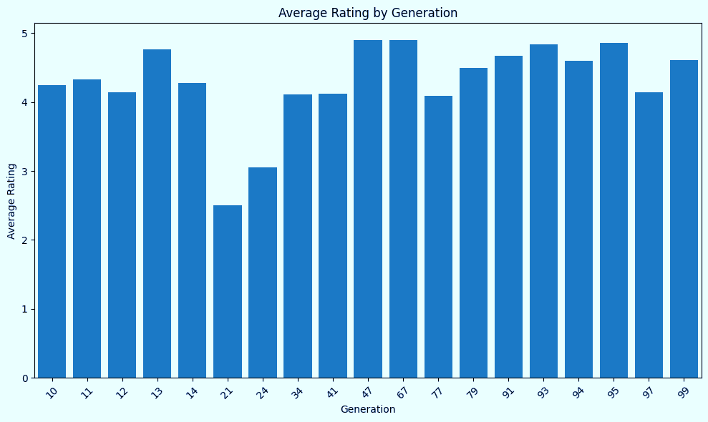
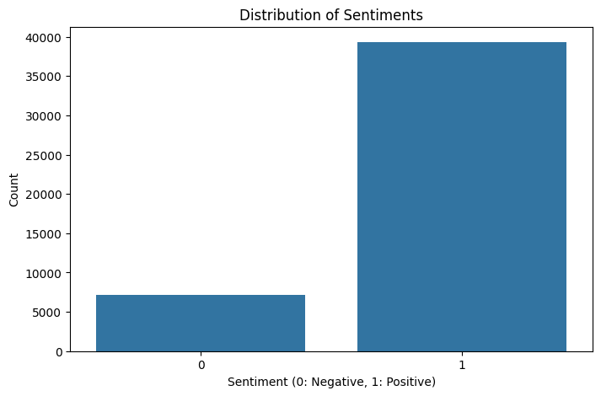
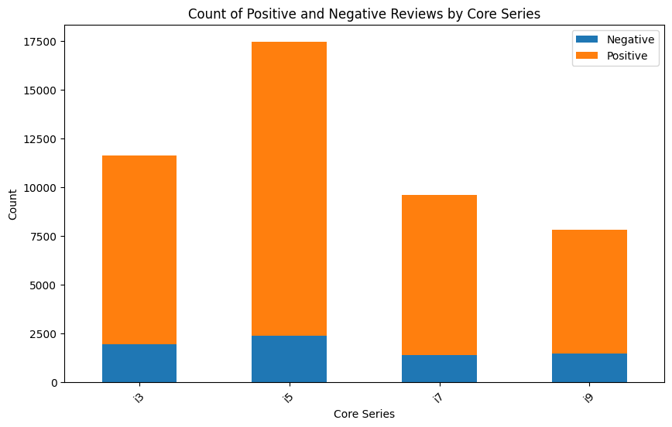
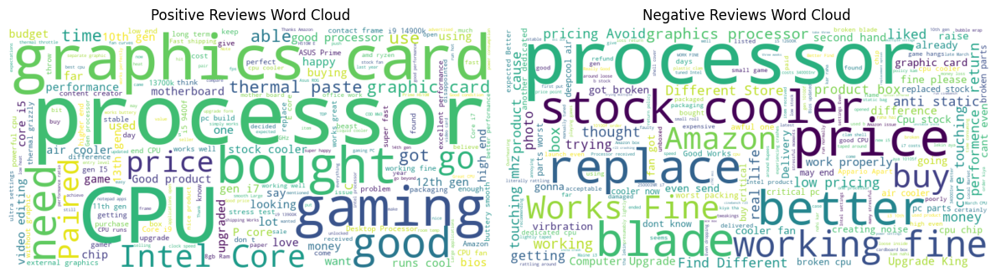
VISUALIZATIONs

Slide 11
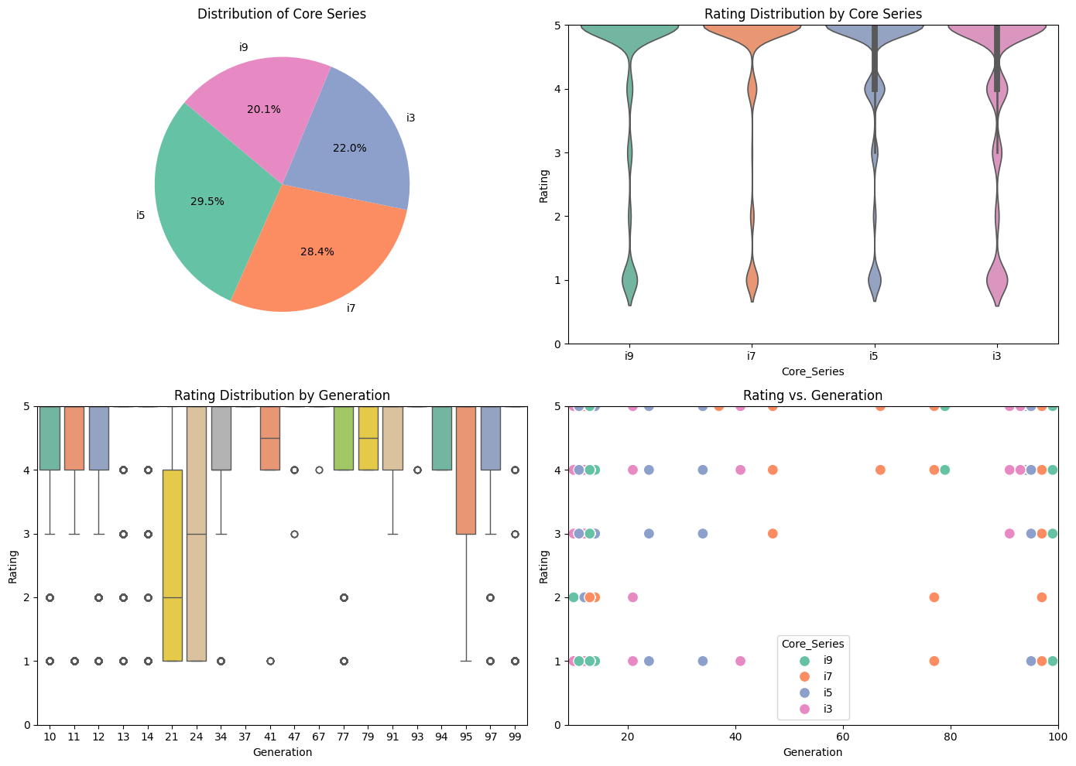
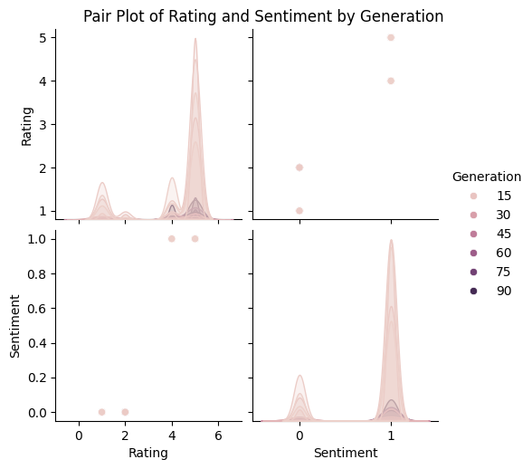
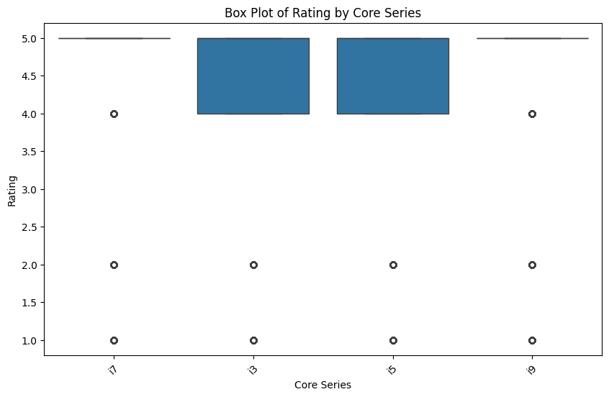
VISUALIZATIONs

Slide 12
Team members and contribution:
MOHAMMED SAQIB.B - Extracted Data From Various Sources For I914thgen And Developed Models.
KISHORE. S - Extracted Data From Various Sources For I712thgen,i713thgen.
KAVIPRIYA.K- Extracted Data From Various Sources For I513thgen, I913thgen, And Developed Presentation.
KEERTHANA.E- Extracted Data From Various Sources For I514thgen,i714thgen,and Developed Documents.
ABDUL RAHMAN.J - Extracted Data From Various Sources For I512thgen, I912thgen And Developed Models.

Slide 13
Key Findings
Sentiment Trends: Over the past 3 to 5 years, there has been a consistent trend towards positive sentiment regarding Intel's performance and reliability in computing solutions.
Feature Preferences: Consumers highly value innovations such as AI integration, enhanced graphics capabilities, and user-friendly designs.
Areas for Improvement: While Intel products generally receive positive feedback, areas such as customer support responsiveness and occasional software issues require attention.
Conclusions

Slide 14
Recommendation
Focus on Innovation: Continue to innovate with cutting-edge technologies like AI and 5G integration to meet the growing demands of tech-savvy consumers.
Enhanced Quality Assurance: Strengthen quality control measures to minimize hardware issues and ensure reliable performance across product lines.
Customer-Centric Design: Prioritize user experience with ergonomic designs, intuitive interfaces, and customizable options that enhance usability and appeal.
4.Proactive Customer Support: Invest in proactive customer support strategies to swiftly address consumer concerns and enhance overall satisfaction.

Slide 15
Thank you!

